Slide 1
How to deploy Removable Storage Access Control/RSAC through GPO?
Doc: Microsoft Defender for Endpoint Device Control Removable Storage Access Control | Microsoft Docs

Slide 2
Use Case: ReadOnly except approved specific media
For any removable storage, ReadOnly
For approved removable storage, full access
Notes:
{36fc9e60-c465-11cf-8056-444553540000}
{88BAE032-5A81-49f0-BC3D-A4FF138216D6}

Slide 3
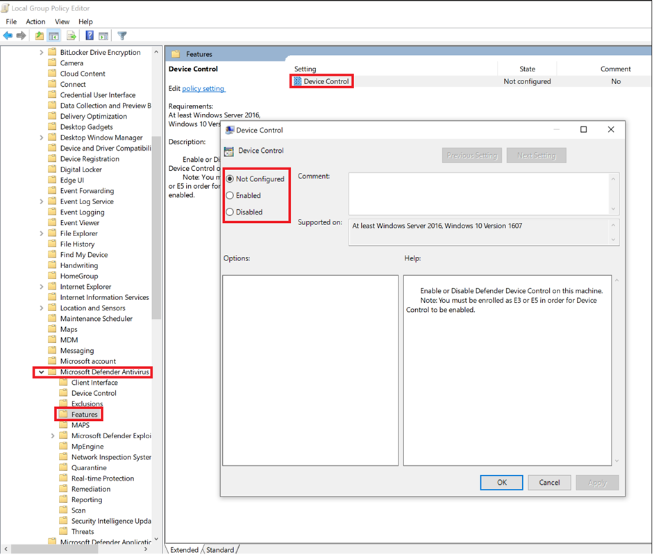
Step 1: Enable RSAC
Computer Configuration > Administrative Templates > Windows Components > Microsoft Defender Antivirus > Features > Device Control :
Enabled
Notes:
{36fc9e60-c465-11cf-8056-444553540000}
{88BAE032-5A81-49f0-BC3D-A4FF138216D6}

Slide 4
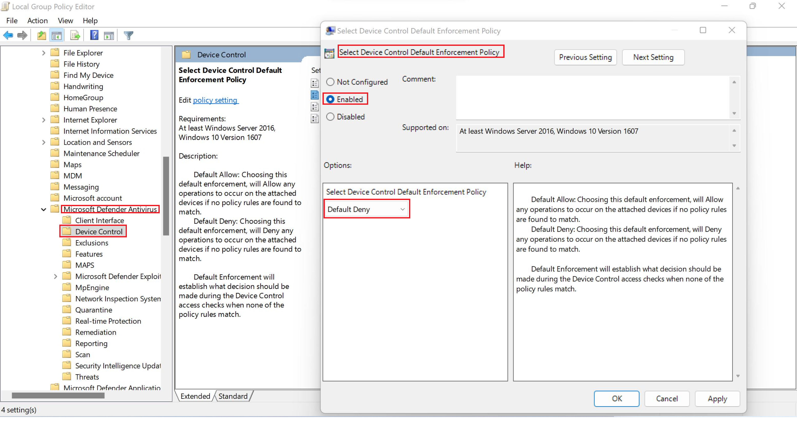
Step 2: Set Default Enforcement = Deny
Computer Configuration > Administrative Templates > Windows Components > Microsoft Defender Antivirus > Device Control > Select Device Control Default Enforcement :
Enabled
Default Deny
Recently we expanded our feature to Printer as well, so please make sure Allow Printer if you only want to manage removable storage.
Notes:
{36fc9e60-c465-11cf-8056-444553540000}
{88BAE032-5A81-49f0-BC3D-A4FF138216D6}

Slide 5
Step 3: Audit Default Deny
Create Audit policy for Default Deny:
<PolicyRule Id="{f3520ea7-fd1b-4237-8ebc-96911db44f8e}">
<!-- Audit default deny -->
<Name>Default Deny</Name>
<IncludedIdList />
<ExcludedIdList />
<Entry Id="{6b9cf286-ec70-4463-bfaf-29f32bb5f0dc}">
<Type>AuditDenied</Type>
<Options>3</Options>
<AccessMask>7</AccessMask>
</Entry>
</PolicyRule>

Slide 6
Step 4: ReadOnly - Group
Create removable storage group for ReadOnly enforcement:
<Group Id="{9b28fae8-72f7-4267-a1a5-685f747a7146}">
<MatchType>MatchAny</MatchType>
<DescriptorIdList>
<PrimaryId>RemovableMediaDevices</PrimaryId>
<PrimaryId>CdRomDevices</PrimaryId>
<PrimaryId>WpdDevices</PrimaryId>
</DescriptorIdList>
</Group>

Slide 7
Step 5: ReadOnly - Policy
Create ReadOnly policy and apply the policy to the ReadOnly removable storage group:
<PolicyRule Id="{f7e75634-7eec-4e67-bec5-5e7750cb9e02}">
<!-- Allow Any Read activity -->
<Name>Allow Read Activity</Name>
<IncludedIdList>
<GroupId>{9b28fae8-72f7-4267-a1a5-685f747a7146}</GroupId>
</IncludedIdList>
<ExcludedIdList>
</ExcludedIdList>
<Entry Id="{27c79875-25d2-4765-aec2-cb2d1000613f}">
<Type>Allow</Type>
<Options>0</Options>
<AccessMask>9</AccessMask>
</Entry>
<Entry Id="{b280c2bf-ca5d-46a1-afc9-7e34d8098ca7}">
<Type>AuditAllowed</Type>
<Options>2</Options>
<AccessMask>9</AccessMask>
</Entry>
</PolicyRule>

Slide 8
Step 6: Create Group for Allowed Medias
Create approved removable storage group:
<Group Id="{65fa649a-a111-4912-9294-fb6337a25038}">
<!-- Approved USBs Group -->
<MatchType>MatchAny</MatchType>
<DescriptorIdList>
<InstancePathId>USBSTOR\DISK&amp;VEN__USB&amp;PROD__SANDISK_3.2GEN1&amp;REV_1.00\03003324080520232521&amp;*</InstancePathId>
</DescriptorIdList>
</Group>
Notes:
{36fc9e60-c465-11cf-8056-444553540000}
{88BAE032-5A81-49f0-BC3D-A4FF138216D6}

Slide 9
Step 7: Create Policy to allow the approved USB Group
Create policy to allow the approved USB group
<PolicyRule Id="{b2061588-029e-427d-8404-6dfec096a571}">
<!-- Allow access and Audit file information -->
<Name>Allow access and Audit file information</Name>
<IncludedIdList>
<GroupId>{65fa649a-a111-4912-9294-fb6337a25038}</GroupId>
</IncludedIdList>
<ExcludedIdList>
</ExcludedIdList>
<Entry Id="{3d5a4360-e9b5-4da5-9214-d22f5ea0b893}">
<Type>Allow</Type>
<Options>0</Options>
<AccessMask>47</AccessMask>
</Entry>
<Entry Id="{0cee54be-b320-4194-9c28-c780d168e158}">
<Type>AuditAllowed</Type>
<Options>2</Options>
<AccessMask>47</AccessMask>
</Entry>
<Entry Id="{5b7657c7-a2f2-4264-9676-198d7bd35e56}">
<Type>Allow</Type>
<Options>16</Options>
<AccessMask>16</AccessMask>
</Entry>
</PolicyRule>
What is ‘47’ means in the policy? It is 9 + 2+ 36 = 47:
Read access: 1+8 = 9
Write access: disk level 2
Execute: 4 + 32 = 36
Notes:
{36fc9e60-c465-11cf-8056-444553540000}
{88BAE032-5A81-49f0-BC3D-A4FF138216D6}

Slide 10
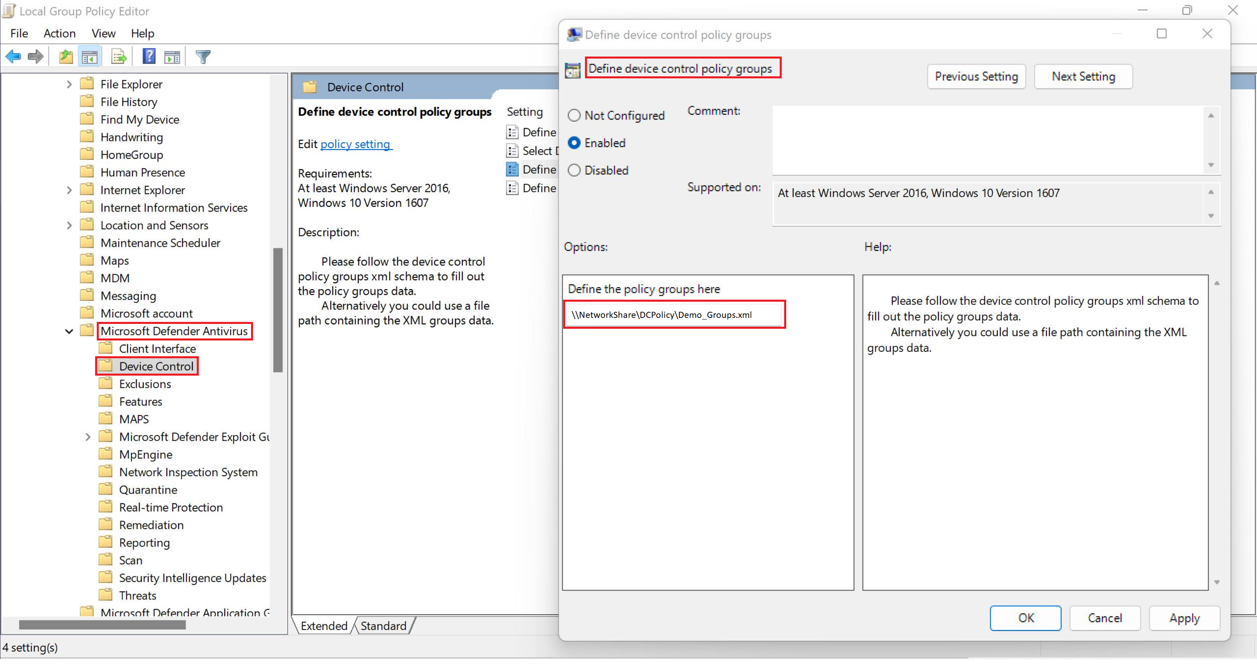
Step 8: Combine the groups into one XML file
Computer Configuration > Administrative Templates > Windows Components > Microsoft Defender Antivirus > Device Control > Define device control policy groups :
<Group Id="{65fa649a-a111-4912-9294-fb6337a25038}">
<!-- Approved USBs Group -->
<MatchType>MatchAny</MatchType>
<DescriptorIdList>
<InstancePathId>USBSTOR\DISK&amp;VEN__USB&amp;PROD__SANDISK_3.2GEN1&amp;REV_1.00\03003324080520232521&amp;*</InstancePathId>
</DescriptorIdList>
</Group>
<Group Id="{9b28fae8-72f7-4267-a1a5-685f747a7146}">
<MatchType>MatchAny</MatchType>
<DescriptorIdList>
<PrimaryId>RemovableMediaDevices</PrimaryId>
<PrimaryId>CdRomDevices</PrimaryId>
<PrimaryId>WpdDevices</PrimaryId>
</DescriptorIdList>
</Group>
XML file download location: mdatp-devicecontrol/Demo_Groups.xml at main · microsoft/mdatp-devicecontrol (github.com)

Slide 11
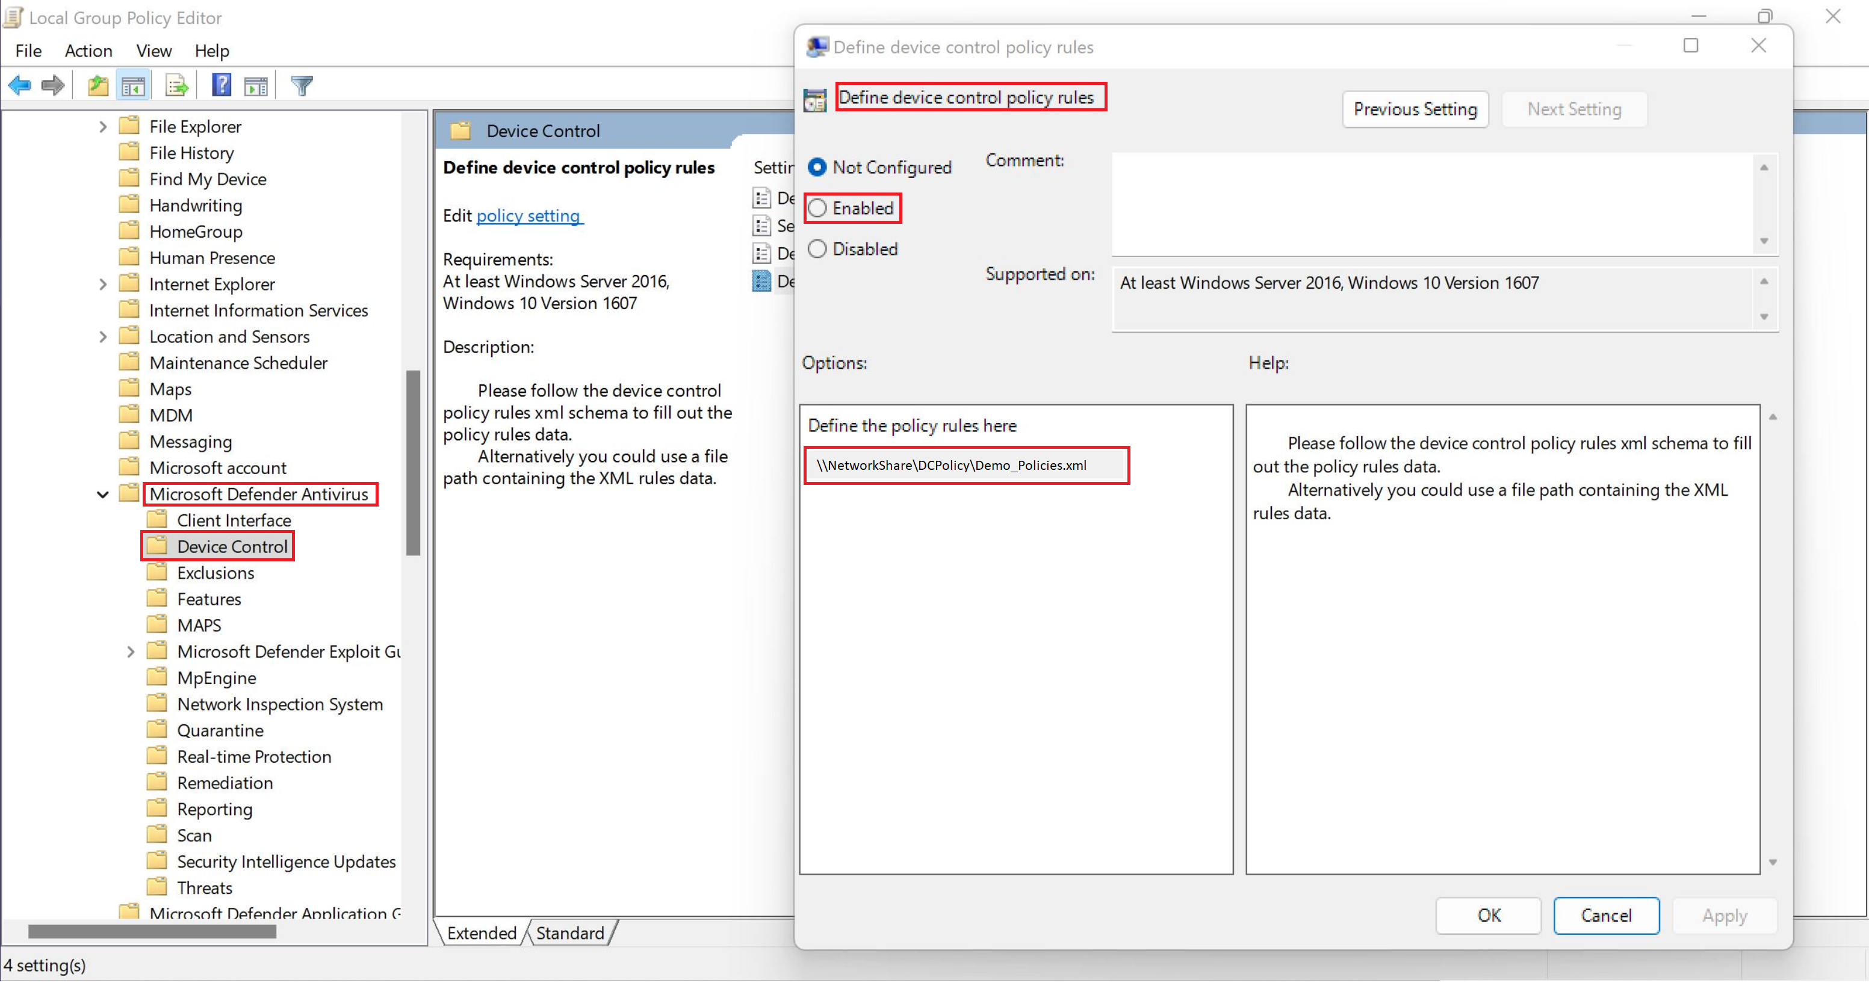
Step 9: Combine the policies into one XML file
Computer Configuration > Administrative Templates > Windows Components > Microsoft Defender Antivirus > Device Control > Define device control policy rules :
<PolicyRules>
<PolicyRule Id="{b2061588-029e-427d-8404-6dfec096a571}">
<!-- Allow access and Audit file information -->
<Name>Allow access and Audit file information</Name>
<IncludedIdList>
<GroupId>{65fa649a-a111-4912-9294-fb6337a25038}</GroupId>
</IncludedIdList>
<ExcludedIdList>
…….too long, please check the xml file from the GitHub
<ExcludedIdList />
<Entry Id="{6b9cf286-ec70-4463-bfaf-29f32bb5f0dc}">
<Type>AuditDenied</Type>
<Options>3</Options>
<AccessMask>7</AccessMask>
</Entry>
</PolicyRule>
</PolicyRules>
XML file download location: mdatp-devicecontrol/Demo_Policies.xml at main · microsoft/mdatp-devicecontrol (github.com)

Slide 12
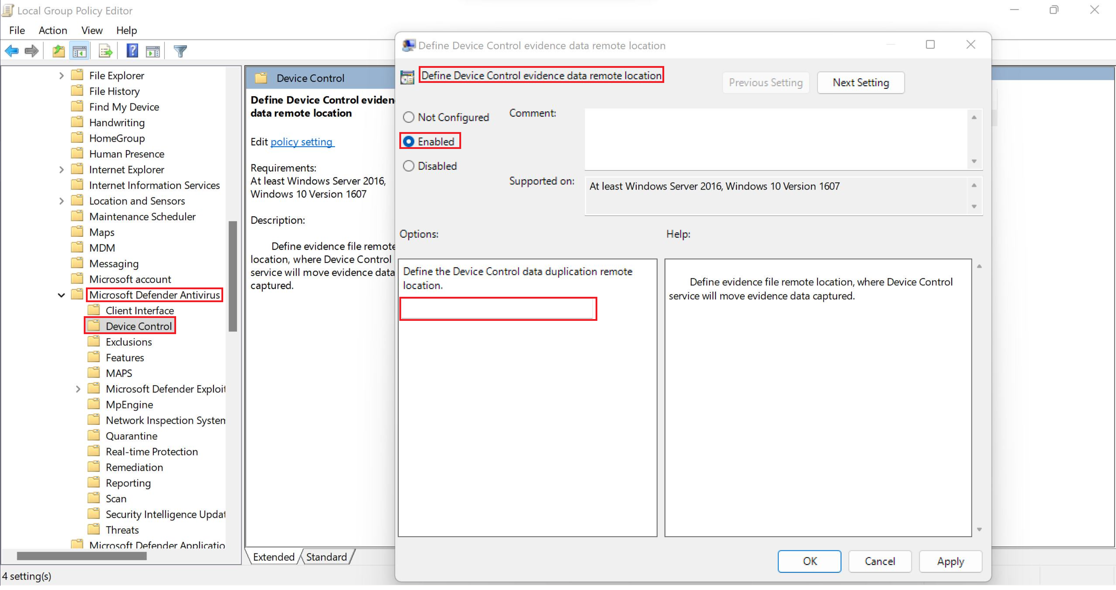
Additional: set evidence file location
Computer Configuration > Administrative Templates > Windows Components > Microsoft Defender Antivirus > Device Control > Define Device Control evidence data remote location :
Data Type: String, any local or network share folder path

Slide 13
Enduser Experience

Slide 14
Audit/Allow mode
There is no notification on the client side, but in the backend the system will fire event for reporting

Slide 15
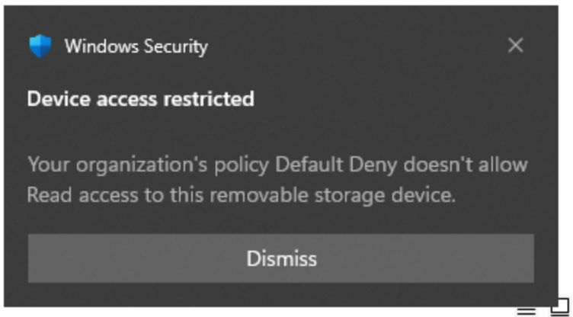
Block mode

Slide 16
End

